Slide 1

BUS 405
Business Studies for Engineers
Organization Visit
Organization Structure of
SELISE digital platforms

Slide 2
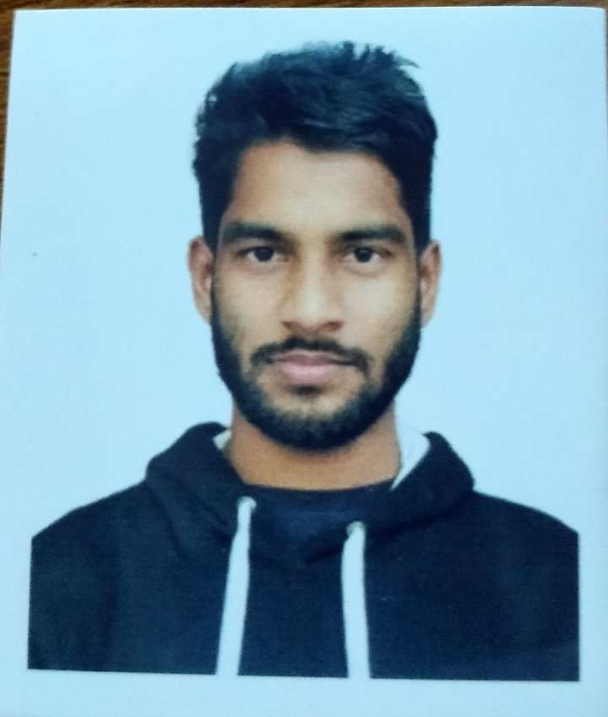
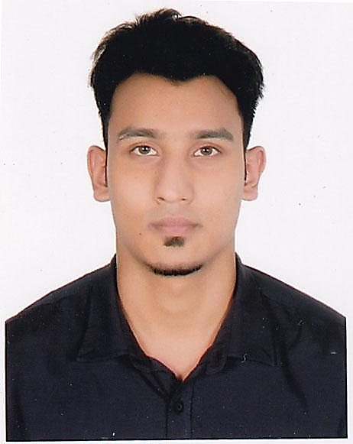
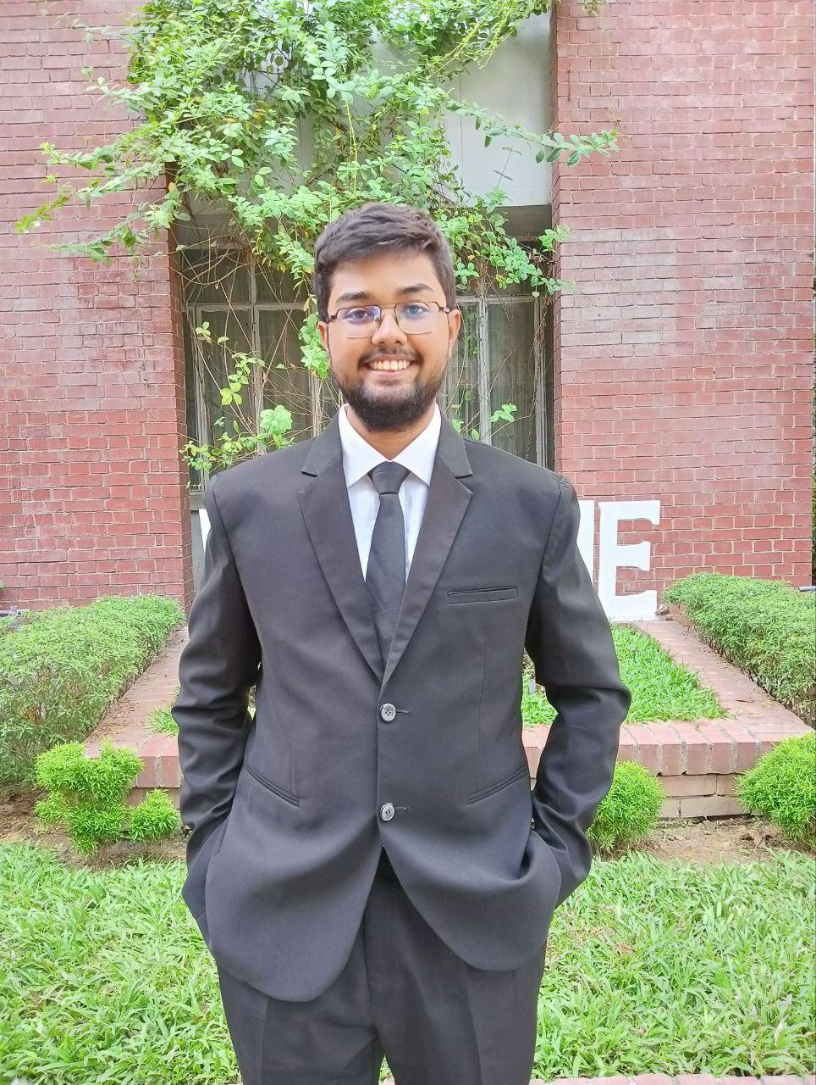
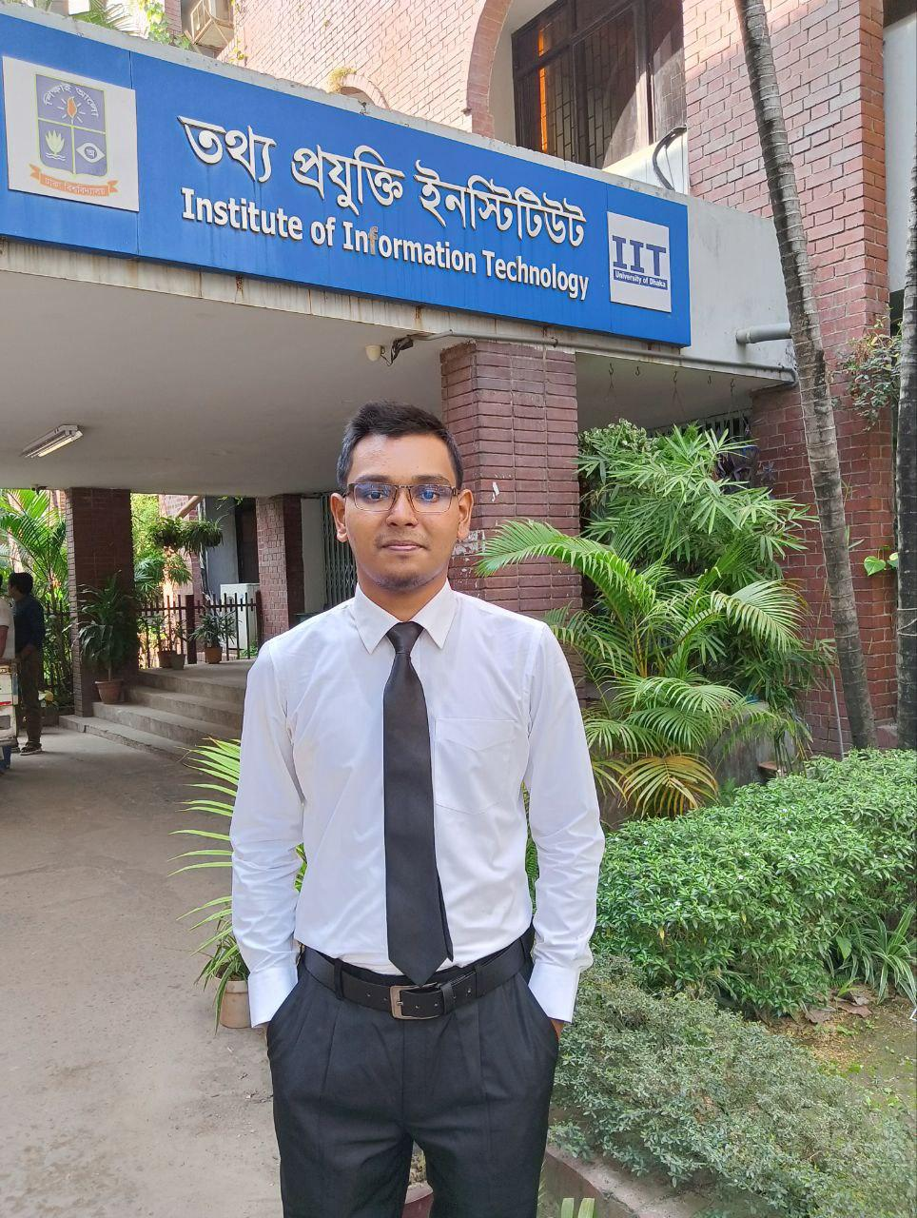
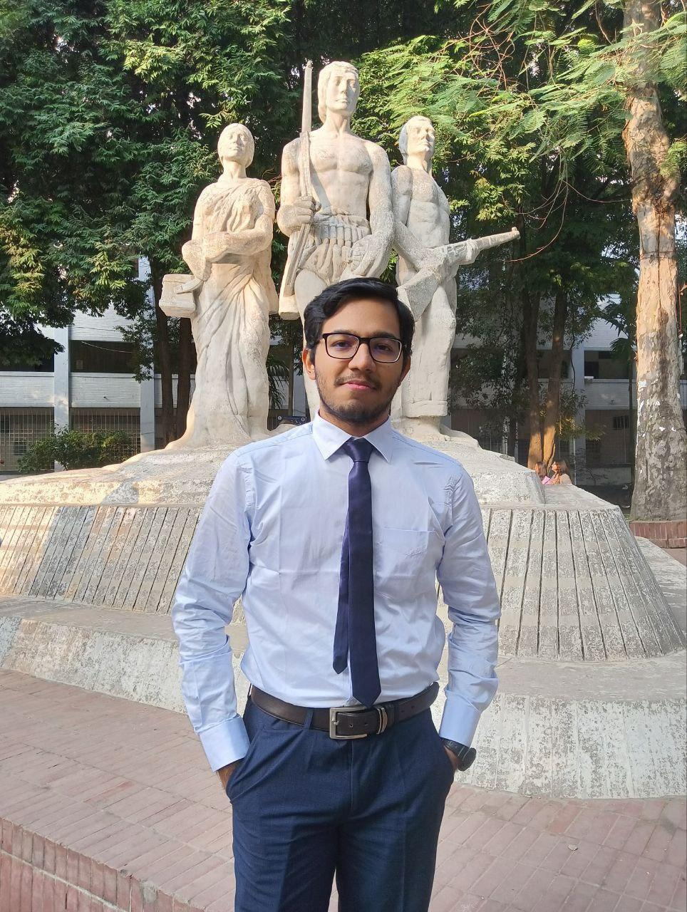
Group Members
A M Samdani Mojumder
BSSE 1412
Md Jihad Hossain
BSSE 1413
Md Mahfuz Ibne Ali Ayon
BSSE 1421
Md Ismail Hossain
BSSE 1433
Nandan Bhowmick
BSSE 1436

Slide 3
About SELISE
SELISE is a global software company originated from Switzerland engaged in the creation of digital platforms from strategy to execution. This renowned firm delivers software engineering and business consulting services to multinationals and startups from different sectors. Headquartered in Switzerland, the company's 100+ creative workforce is distributed over Zürich, Dubai, Thimphu, and Dhaka. Their understanding of information technology and the internet helps to enhance business performance across industries.

Slide 4
Departmentalization

Slide 5
Functional
Business Support
Digital Transfer & Operation
Academy
Retail
Insurance & Banking
HR
Finance & Admins
Manufacture & Engineering
Geographical
Zürich, Switzerland
Dubai, UAE
Thimphu, Bhutan
Dhaka, Bangladesh
Customer
Financial organization
Retail sector
Manufacturing industry
Food industry
Telecommunications organization

Slide 6
Chain of Command

Slide 7
Board of Directors
CEO
CPO
CCO
Vice President
Business Head
Technology Head
Business Manager
Product Manager
Business Analyst
Development Manager
Associate Analyst
Software Engineer

Slide 8
Span of Control

Slide 9
Span of control refers to the number of subordinates a manager directly supervises.
SELISE follows the ideal span of control, which depends on various factors like the teams size, complexity, industry, and even the manager's capabilities. It doesn’t have a fixed span of control, it varies across teams depending on the factors mentioned.
Currently each team members reports to team head. Team head then reports to HR and so on.

Slide 10
Centralization and Decentralization

Slide 11
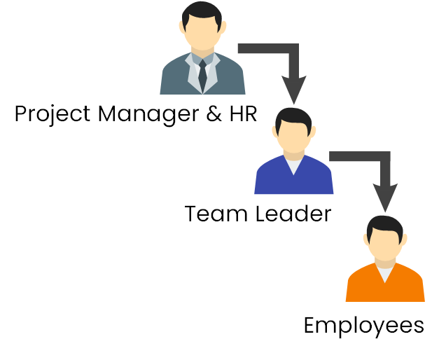
SELISE predominantly employs a centralized structure, where the major company decisions are made by the executive directors and above from the main headquarters in Switzerland, while less significant decisions are made by the country managers/heads based on the local needs and rules.

Slide 12
Formalization

Slide 13
Formalization in an organization is the degree to which fixed rules and procedures dictate how employees should behave.
SELISE is an organic organization that employs highly flexible and adaptable structure. The company offers flexible working hours, has a relaxed dress code and encourages creativity in the workplace. They arrange scrum meetings everyday. These meetings are mostly held in an informal manner. The HR monitors and motivates employees to ensure a friendly communication.

Slide 14
Work Specialization

Slide 15
SELISE highly focuses on work specialization to increase their productivity and achieve their business goal. In each sector they try to hire specialist person on that domain.
The topmost positions are managed by those who are highly specialized in decision making and planning.
In Technical department, specific technology skilled person are hired for that position.
In Business department, experienced and specialized person are hired for business planning and monitoring.

Slide 16
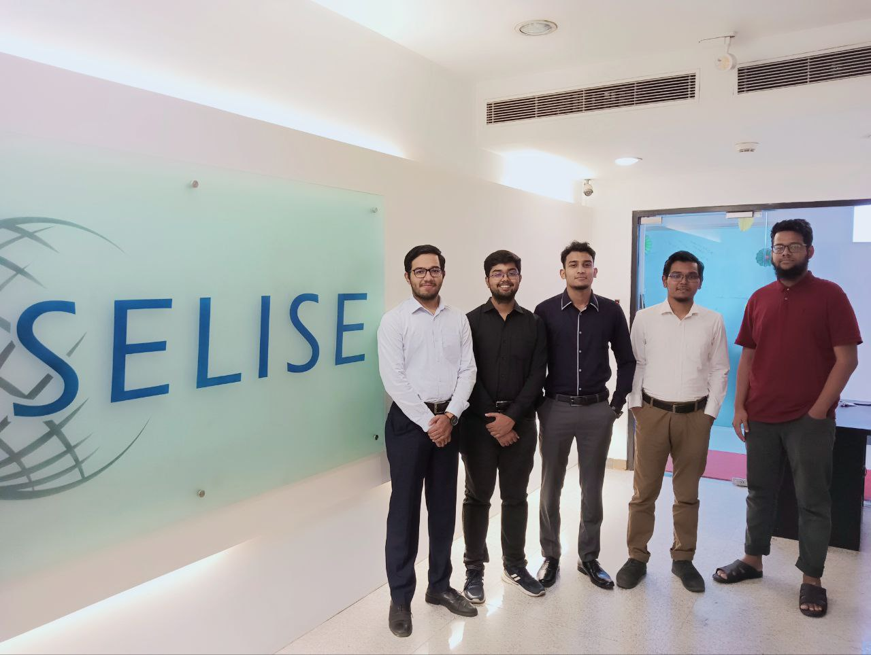

Slide 17
Thank You

